Slide 1
Working with layout and Responsive Web Design04
Session 5
(slot 8-9)

Slide 2
Content
Web layout using DIV,SPAN
Web layout using table
Create your own responsive design

Slide 3
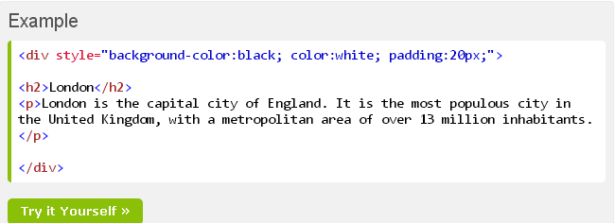
Div element
<div> element is a block level element that can be used as a container for other HTML elements.

Slide 4
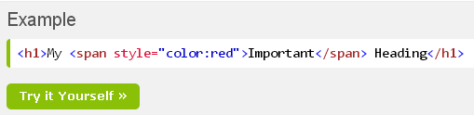
Span element
The HTML <span> element is an inline element that can be used as a container for text.

Slide 5
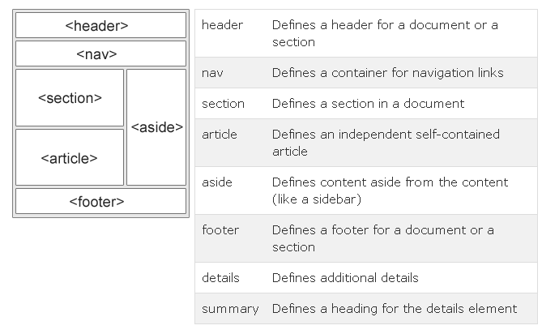
HTML layout
Websites often display content in multiple columns (like a magazine or newspaper).

Slide 6
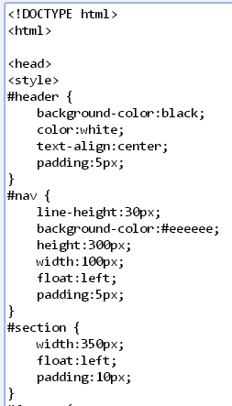
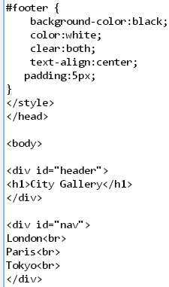
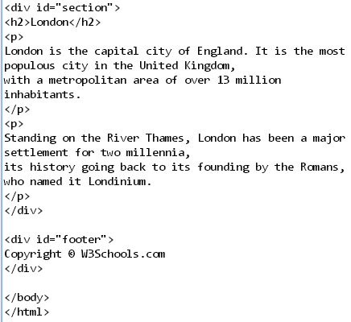
Using div tag

Slide 7
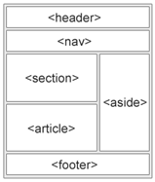
HTML layout using table
Ex: 4 rows, 1 col
At this row, insert a table has 2 rows , 2 cols
Rowspan=2

Slide 8
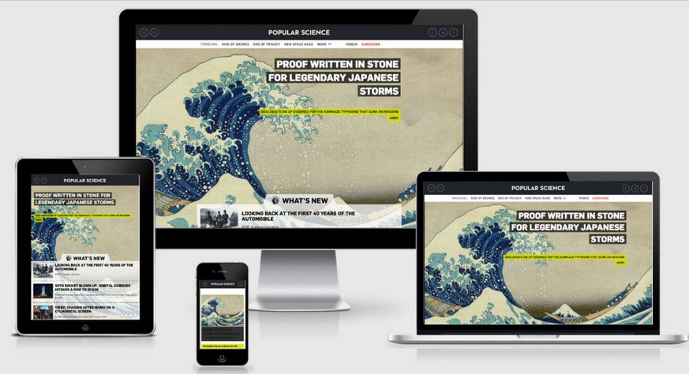
HTML Responsive Web Design
RWD stands for Responsive Web Design
RWD can deliver web pages in variable sizes
RWD is a must for tablets and mobile devices

Slide 9
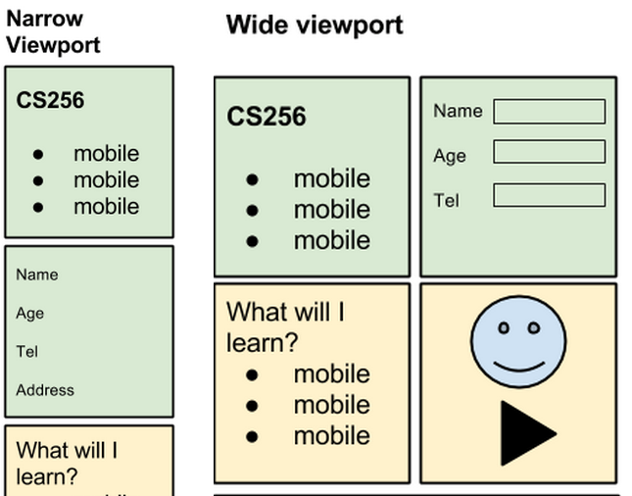

Create your page structure

Slide 10
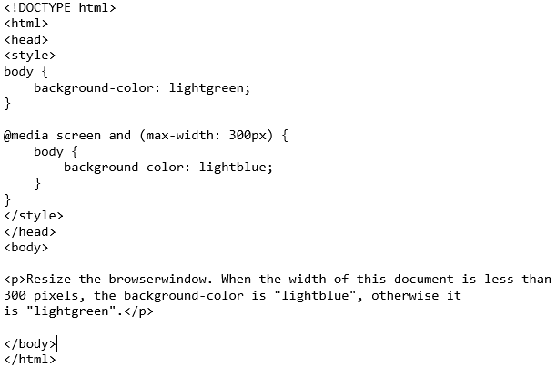

RWD by use @media in css3 / link tag

Slide 11
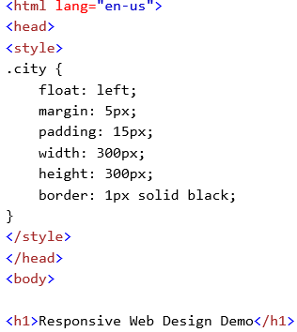
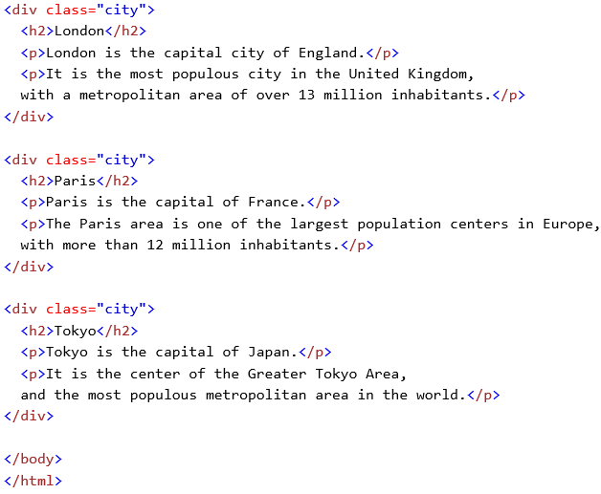
create RWD by yourself

Slide 12
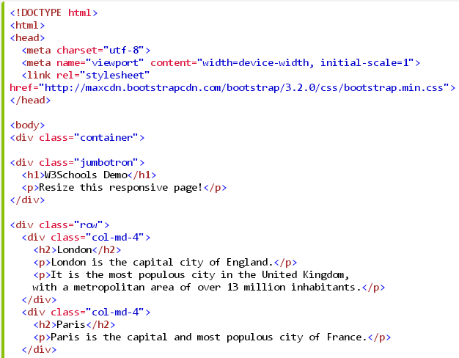
Using Meta’s attribute

Slide 13
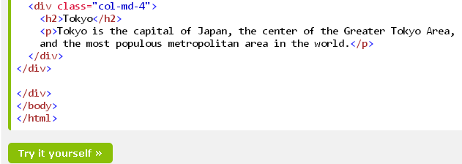

Slide 14
summary
A webpage layout is very important to give better look to your website
Responsive web design (RWD) is an approach to web design aimed at crafting sites to provide an optimal viewing across a wide range of devices

Slide 15
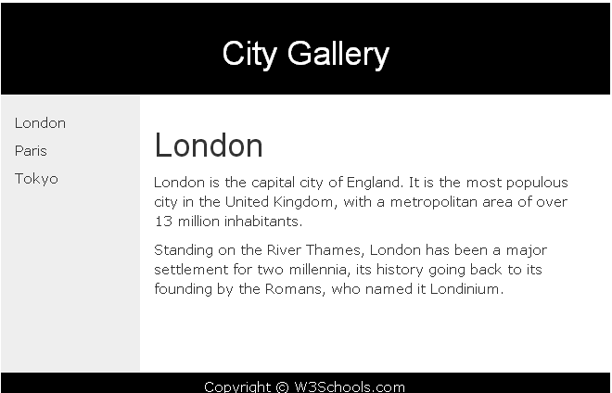
exercise

